Slide 1
Standard Deviation
Year 11 Essentials
Miss Lum

Slide 2
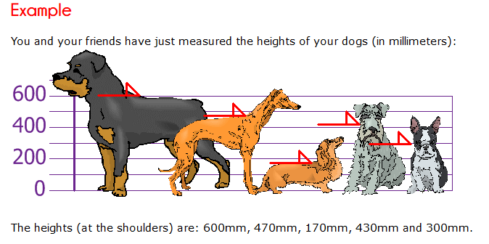

Step 1: Calculate the Mean

Slide 3
Step 2: Calculate the distance
Value - Mean | 600 – 394 = 206 | 470 – 394 = 76 | 170 – 394 = -224 | 430 – 394 = 36 | 300 – 394 = -94

Slide 4
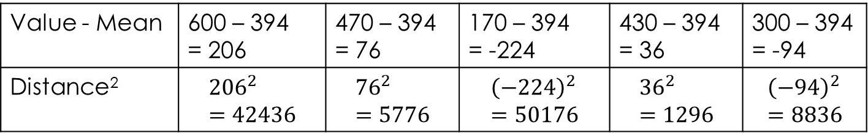
Step 3: Square the distance
Value - Mean | 600 – 394 = 206 | 470 – 394 = 76 | 170 – 394 = -224 | 430 – 394 = 36 | 300 – 394 = -94
Distance² | $${206}^{2}=42436$$ | $${76}^{2}=5776$$ | $${\left(−224\right)}^{2}=50176$$ | $${36}^{2}=1296$$ | $${\left(−94\right)}^{2}=8836$$

Slide 5



Step 4: Calculate the mean of the square distances
Value - Mean | 600 – 394 = 206 | 470 – 394 = 76 | 170 – 394 = -224 | 430 – 394 = 36 | 300 – 394 = -94
Distance² | $${206}^{2}=42436$$ | $${76}^{2}=5776$$ | $${\left(−224\right)}^{2}=50176$$ | $${36}^{2}=1296$$ | $${\left(−94\right)}^{2}=8836$$
$$Variance=\frac{42436+5776+50176+1296+8836}{5}$$
$$Variance=\frac{108 520}{5}$$
$$Variance=21704$$

Slide 6

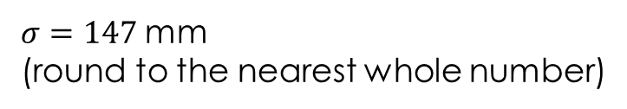


Step 5: Find the Square Root of the VAriance
Value - Mean | 600 – 394 = 206 | 470 – 394 = 76 | 170 – 394 = -224 | 430 – 394 = 36 | 300 – 394 = -94
Distance² | $${206}^{2}=42436$$ | $${76}^{2}=5776$$ | $${\left(−224\right)}^{2}=50176$$ | $${36}^{2}=1296$$ | $${\left(−94\right)}^{2}=8836$$
$$Variance=21704$$
$$σ=\sqrt{21704}$$
$$σ=147.32$$
$σ=147$mm
(round to the nearest whole number)

Slide 7
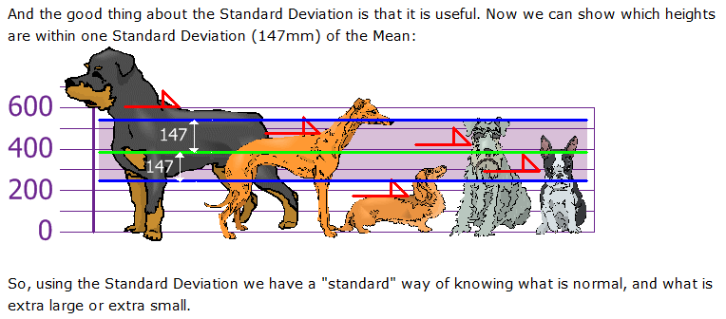
Step 5: What does the Standard Deviation Show?

Slide 8
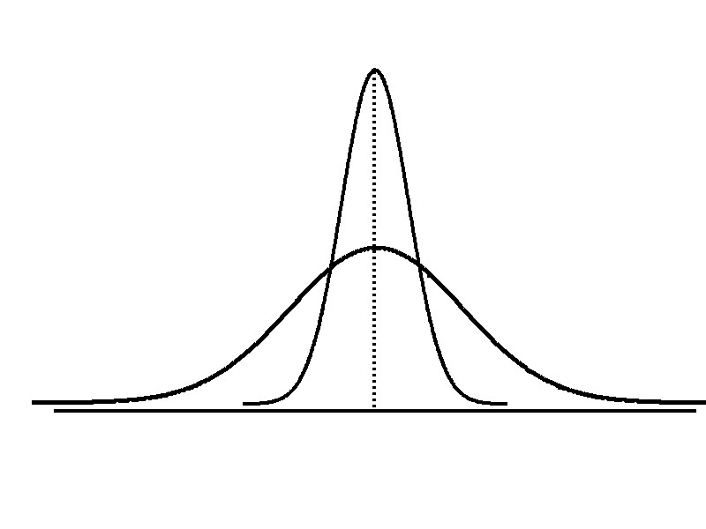
Measures of Dispersion: Comparing Standard Deviations
Smaller standard deviation
Larger standard deviation

Slide 9
Measures of Dispersion: Comparing Standard Deviations
The standard deviation is a number that measures how far away each number in a set of data is from their mean.
If the Standard Deviation is large, it means the numbers are spread out from their mean. If the Standard Deviation is small, it means the numbers are close to their mean.
large,
small,

